Slide 1
UFCFVK-15-2 Internet of Things
Network protocols

Slide 2
TCP/IP

Slide 3
TCP/IP Protocol Family
IP : Internet Protocol
UDP : User Datagram Protocol
RTP, traceroute
TCP : Transmission Control Protocol
HTTP, FTP, ssh

Slide 4
What is an internet?
A set of interconnected networks
The Internet is the most famous example
Networks can be completely different
Ethernet, ATM, modem, …
(TCP/)IP is what links them

Slide 5
What is an internet? (cont)
Routers (nodes) are devices on multiple networks that pass traffic between them
Individual networks pass traffic from one router or endpoint to another
TCP/IP hides the details as much as possible

Slide 6
ISO/OSI Network Model
Seven network “layers”
Layer 1 : Physical – cables
Layer 2 : Data Link – Ethernet
Layer 3 : Network – IP
Layer 4 : Transport – TCP/UDP
Layer 5 : Session
Layer 6 : Presentation
Layer 7 : Application
You don’t need to know the layers just the idea that it is layered

Slide 7
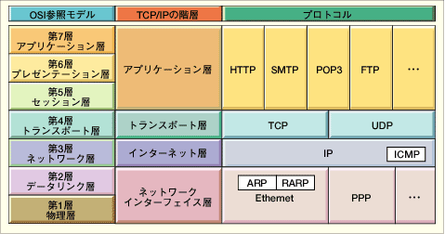
OSI: Open Systems Interconnect OSI and Protocol Stack
OSI Model
TCP/IP Hierarchy
Protocols
7th
Application Layer
6th
Presentation Layer
Application Layer
5th
Session Layer
4th
Transport Layer
Transport Layer
3rd
Network Layer
Network Layer
2nd
Link Layer
Link Layer
1st
Physical Layer
Link Layer : includes device driver and network interface card
Network Layer : handles the movement of packets, i.e. Routing
Transport Layer : provides a reliable flow of data between two hosts
Application Layer : handles the details of the particular application

Slide 8
Address Resolution Protocol (ARP)
It is a procedure for mapping a dynamic IP address to a permanent physical machine address in a local area network (LAN). The physical machine address is also known as a media access control (MAC) address.
The job of ARP is essentially to translate 32-bit addresses to 48-bit addresses and vice versa. This is necessary because IP addresses in IP version 4 (IPv4) are 32 bits, but MAC addresses are 48 bits.
ARP works between Layers 2 and 3 of the Open Systems Interconnection model (OSI model). The MAC address exists on Layer 2 of the OSI model, the data link layer. The IP address exists on Layer 3, the network layer.

Slide 9
224
132
6
17
1110 0000
1000 0100
0000 0110
0001 0001
First half (3 bytes, 24 bytes) of multicast MAC will always be 01:00:5E
The second half of the MAC comes from the last 23 bits of the Multicast IP address
1110 0000
1000 0100
0000 0110
0001 0001
In hex
04
06
11
Final MAC for the multicast group would be
01:00:5E
:04:06:11

Slide 10
RARP
Client computer to request its IP address from a gateway server’s Address Resolution Protocol table or cache.
The network administrator creates a table in gateway-router, which is used to map the MAC address to corresponding IP address.
This protocol is used to communicate data between two points in a server.
The client doesn’t necessarily need prior knowledge, the server identities capable of serving its request.
Medium Access Control (MAC) addresses requires individual configuration on the servers done by an administrator.
RARP limits to the serving of IP addresses only.

Slide 11
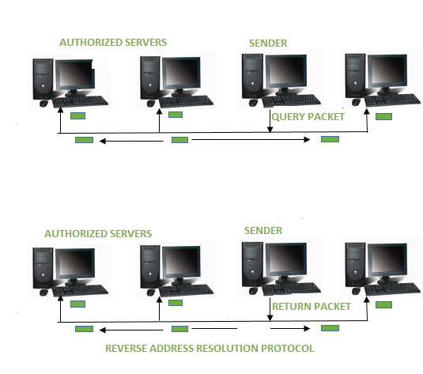

Slide 12
Point - to - Point Protocol (PPP) is a communication protocol of the data link layer that is used to transmit multiprotocol data between two directly connected (point-to-point) computers.
Services Provided by PPP
Defining the frame format of the data to be transmitted.
Defining the procedure of establishing link between two points and exchange of data.
Method of encapsulation of network layer data in the frame.
Stating authentication rules of the communicating devices.
Providing address for network communication.
Providing connections over multiple links.

Slide 13
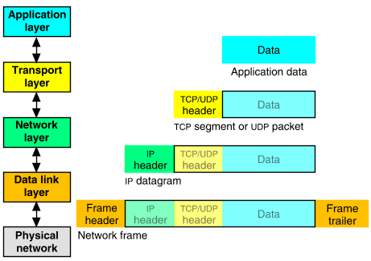
Packet Encapsulation
The data is sent down the protocol stack
Each layer adds to the data by prepending headers
22Bytes
20Bytes
20Bytes
4Bytes
64 to 1500 Bytes

Slide 14
IP
Responsible for end to end transmission
Sends data in individual packets
Maximum size of packet is determined by the networks
Fragmented if too large
Unreliable
Packets might be lost, corrupted, duplicated, delivered out of order

Slide 15
IP addresses
4 bytes
e.g. 163.1.125.98
Each device normally gets one (or more)
In theory there are about 4 billion available
But…

Slide 16
Address range
Network Address | Usable Host Range
CLASS A
1.0.0.0 to 126.255.255.255
CLASS B
128.0.0.0 to 191.255.255.255
CLASS C
192.0.0.0 to 223.255.255.255
CLASS D
224.0.0.0 to 239.255.255.255
Reserved for Multicasting
CLASS E
240.0.0.0 to 254.255.255.255
Experimental
127.0.0.0 to 127.255.255.255 cannot be used and it is reserved for loopback testing

Slide 17
Class A
Subnet-mask hides (or masks) the network part of a system's IP address and
A subnet mask leaves only the host part as the machine identifier.
An IPv4 address will have four sections of one to three numbers, separated by dots.
MASK
255
.
.
.
0
0
0
.
.
.
0000 0000
1111 1111
0000 0000
0000 0000
1
1
Bit’s position
⁴
³
⁴
³
⁸
⁷
⁵
²
⁸
⁷
⁵
²
⁶
⁶
2⁷
2⁶
2⁵
2⁴
2³
2²
2¹
2⁰
2⁷
2⁶
2⁵
2⁴
2³
2²
2¹
2⁰
4th Octet all Network bits are present
1st Octet all Network bits are absent
2nd & 3rd Octet all Network bits are absent

Slide 18
The largest Class A networks use a subnet mask of 255.0.0.0, allowing for up to 16,777,216 IP addresses (256 x 256 x 256).

Slide 19
CLASS - A
To find the number of subnets and hosts in each subnet we need to choose the octet which has the combination of 0’s & 1’s
11 .
11 .
12.
45
/9
/9
1111 1111 1000 0000 0000 0000 0000 0000
Network bits
Network bit +Host bits
Host Bits
Host bits
1111 1111
1000 0000
0000 0000
0000 0000
255
128
0
0
2^{n}
2¹
2
Sub networks
⁼
Where n is the number of network bits
2⁷
128
126
Hosts per sub networks
2^{n}
_
_
⁼
_
⁼
²
²
²
Where the first 1 is the network address
Where the second 1 is the broadcast address
Where n is the number of host bits

Slide 20
Sub-Network 1
Network
128.0.0
Network address
Network address
11.0.0.0
11.128.0.0
0
11.0.0.1
1
2
_{128.0.2}
_{128.255.254}
126
_{128.0.1}
₁₂₇
11.127.255.255
255.255
Broadcast address
11.255.255.255
Broadcast address
Network Address | Usable Host Range | Broadcast Address:
11.0.0.0 | 11.0.0.1 to 11.126.255.254 | 11.127.255.255
11.128.0.0 | 11.128.0.1 to 11.255.255.254 | 11.255.255.255
Sub-Network 2

Slide 21
Routing
How does a device know where to send a packet?
All devices need to know what IP addresses are on directly attached networks
If the destination is on a local network, send it directly there

Slide 22
Routing (cont)
If the destination address isn’t local
Most non-router devices just send everything to a single local router
Routers need to know which network corresponds to each possible IP address

Slide 23
IP packets
Source and destination addresses
Protocol number
1 = ICMP, 6 = TCP, 17 = UDP
Various options
e.g. to control fragmentation
Time to live (TTL)
Prevent routing loops

Slide 24
IP Datagram
0
4
8
16
19
24
31
Vers
Len
TOS
Total Length
Identification
Flags
Fragment Offset
TTL
Protocol
Header Checksum
Source Internet Address
Destination Internet Address
Options...
Padding
Data...
Field Purpose
Vers IP version number
Len Length of IP header (4 octet units)
TOS Type of Service
T. Length Length of entire datagram (octets)
Ident. IP datagram ID (for frag/reassembly)
Flags Don’t/More fragments
Frag Off Fragment Offset
Field Purpose
TTL Time To Live - Max # of hops
Protocol Higher level protocol (1=ICMP,
6=TCP, 17=UDP)
Checksum Checksum for the IP header
Source IA Originator’s Internet Address
Dest. IA Final Destination Internet Address
Options Source route, time stamp, etc.
Data... Higher level protocol data
Notes:
16

Slide 25
IP Routing
Source
Destination
Application
Application
Transport
Router
Transport
Network
Network
Network
Link
Link
Link
Routing Table
Destination IP address
IP address of a next-hop router
Flags
Network interface specification

Slide 26
UDP
Thin layer on top of IP
Adds packet length + checksum
Guard against corrupted packets
Also source and destination ports
Ports are used to associate a packet with a specific application at each end
Still unreliable:
Duplication, loss, out-of-orderness possible

Slide 27
UDP datagram
0
16
31
Source Port
Destination Port
Length
Checksum
Application data
Field Purpose
Source Port 16-bit port number identifying originating application
Destination Port 16-bit port number identifying destination application
Length Length of UDP datagram (UDP header + data)
Checksum Checksum of IP pseudo header, UDP header, and data
Notes:
21

Slide 28
Error Deduction through Check sum
32 bit message
1 | 0 | 1 | 0 | 1 | 0 | 1 | 0 | 0 | 0 | 0 | 0 | 0 | 0 | 0 | 0 | 1 | 0 | 0 | 0 | 1 | 0 | 0 | 0 | 1 | 0 | 0 | 0 | 1 | 0 | 0 | 1

Slide 29
Sender side
L
1 |  |  |  | 1
 | 1 | 0 | 1 | 0 | 1 | 0 | 1 | 0
 | 0 | 0 | 0 | 0 | 0 | 0 | 0 | 0
 | 1 | 0 | 0 | 0 | 1 | 0 | 0 | 0
 | 1 | 0 | 0 | 0 | 1 | 0 | 0 | 1
 | 1 | 0 | 1 | 1 | 1 | 0 | 1 | 1
 |  |  |  |  |  |  |  | 1
 | 1 | 0 | 1 | 1 | 1 | 1 | 0 | 0
 | 0 | 1 | 0 | 0 | 0 | 0 | 1 | 1
carry
sum
Wrap sum
Checksum
1’s Complement

Slide 30
Receiver side
L
1 |  |  |  | 1 |  | 1 | 1
 | 1 | 0 | 1 | 0 | 1 | 0 | 1 | 0
 | 0 | 0 | 0 | 0 | 0 | 0 | 0 | 0
 | 1 | 0 | 0 | 0 | 1 | 0 | 0 | 0
 | 1 | 0 | 0 | 0 | 1 | 0 | 0 | 1
 | 0 | 1 | 0 | 0 | 0 | 0 | 1 | 1
 | 1 | 1 | 1 | 1 | 1 | 1 | 1 | 0
 |  |  |  |  |  |  |  | 1
 | 1 | 1 | 1 | 1 | 1 | 1 | 1 | 1
 | 0 | 0 | 0 | 0 | 0 | 0 | 0 | 0
carry
Checksum
sum
Wrap sum
All 0’s No error
1’s Complement

Slide 31
Typical applications of UDP
Where packet loss etc is better handled by the application than the network stack
Where the overhead of setting up a connection isn’t wanted
VOIP
NFS – Network File System
Most games

Slide 32
TCP
Reliable, full-duplex, connection-oriented, stream delivery
Interface presented to the application doesn’t require data in individual packets
Data is guaranteed to arrive, and in the correct order without duplications
Or the connection will be dropped
Imposes significant overheads

Slide 33
Applications of TCP
Most things!
HTTP, FTP (port number 21), SFTP/SSH (port number 22) …

Slide 34
TCP implementation
Connections are established using a three-way handshake
Data is divided up into packets by the operating system
Packets are numbered, and received packets are acknowledged
Connections are explicitly closed
(or may abnormally terminate)

Slide 35
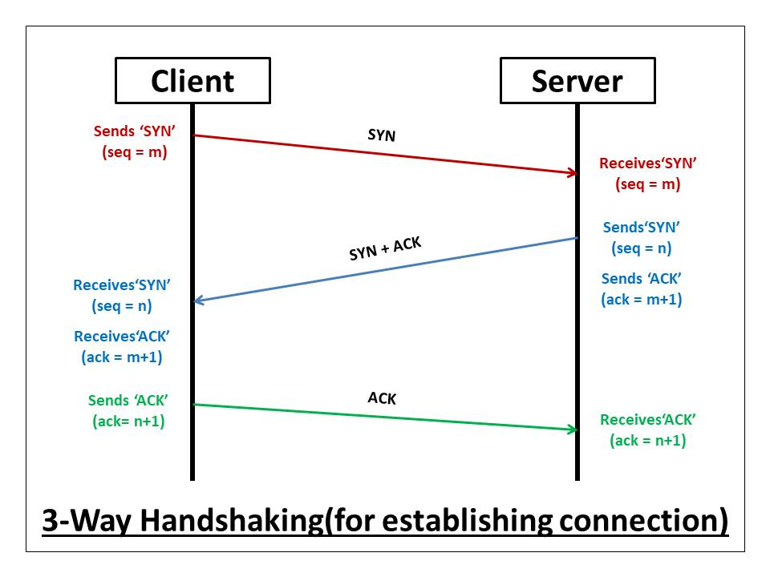

Slide 36
TCP Packets
Source + destination ports
Sequence number (used to order packets)
Acknowledgement number (used to verify packets are received)

Slide 37
TCP Segment
0
4
10
16
19
24
31
Source Port
Destination Port
Sequence Number
Acknowledgment Number
Len
Reserved
Flags
Window
Checksum
Urgent Pointer
Options...
Padding
Data...
Field Purpose
Source Port Identifies originating application
Destination Port Identifies destination application
Sequence Number Sequence number of first octet in the segment
Acknowledgment # Sequence number of the next expected octet (if ACK flag set)
Len Length of TCP header in 4 octet units
Flags TCP flags: SYN, FIN, RST, PSH, ACK, URG
Window Number of octets from ACK that sender will accept
Checksum Checksum of IP pseudo-header + TCP header + data
Urgent Pointer Pointer to end of “urgent data”
Options Special TCP options such as MSS and Window Scale
You just need to know port numbers, seq and ack are added
Notes:
27

Slide 38
TCP : Data transfer
Client
Host
Send Packet 1
Start Timer
Packet Lost
Timer
Packet should arrive
ACK should be sent
ACK would normally
Arrive at this time
Time Expires
Retransmit Packet1
Start Timer
Receive Packet 1
Send ACK 1
Timer
Receive ACK 1
Cancel Timer

Slide 39
IPv6
128 bit addresses
Make it feasible to be very wasteful with address allocations
Lots of other new features
Built-in autoconfiguration, security options, …
Not really in production use yet

